Slide 1
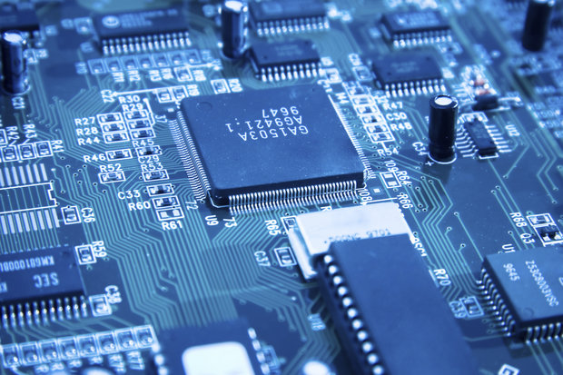
FUNDAMENTALS
OF
HARDWARE
HARDWARE
FUNDAMENTALS

Slide 2
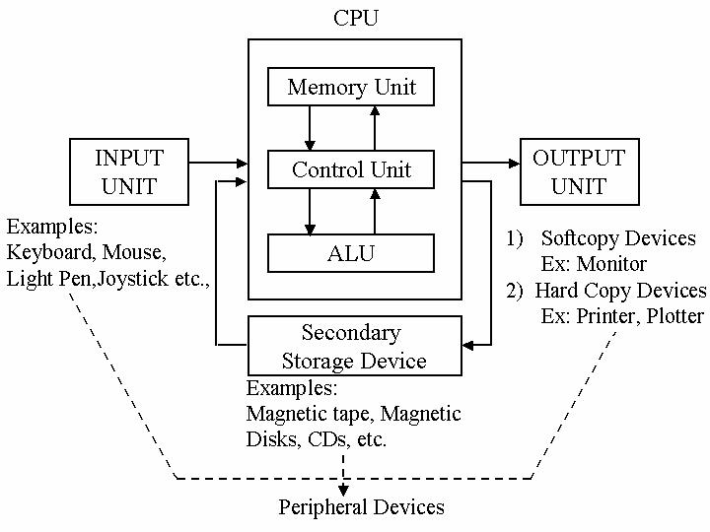
What is a Computer ?
A computer is an electronic device that manipulates information, or data. It has the ability to store, retrieve, and process data.
Block Diagram of Computer

Slide 3
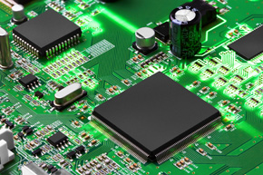

HARDWARE & SOFTWARE
Hardware: Computer hardware is any physical device used in or with your machine.
Software: Software is a collection of instructions that enable the user to interact with a computer, its hardware, or perform tasks.

Slide 4
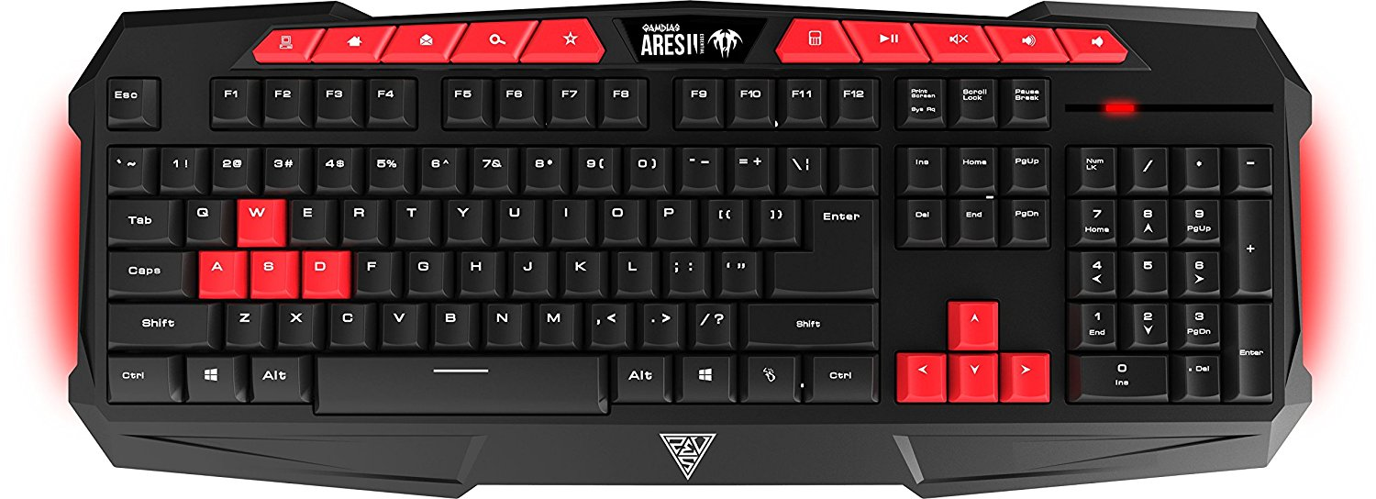
KEYBOARD
MEMBRANE KEYBOARD

Slide 5
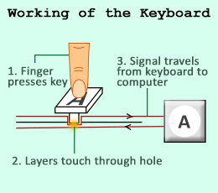
WORKING PRINCIPLE
Inside the keyboard, there are metallic plate, circuit board and processor, which are responsible for transferring information from the keyboard to the computer.

Slide 6
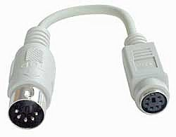
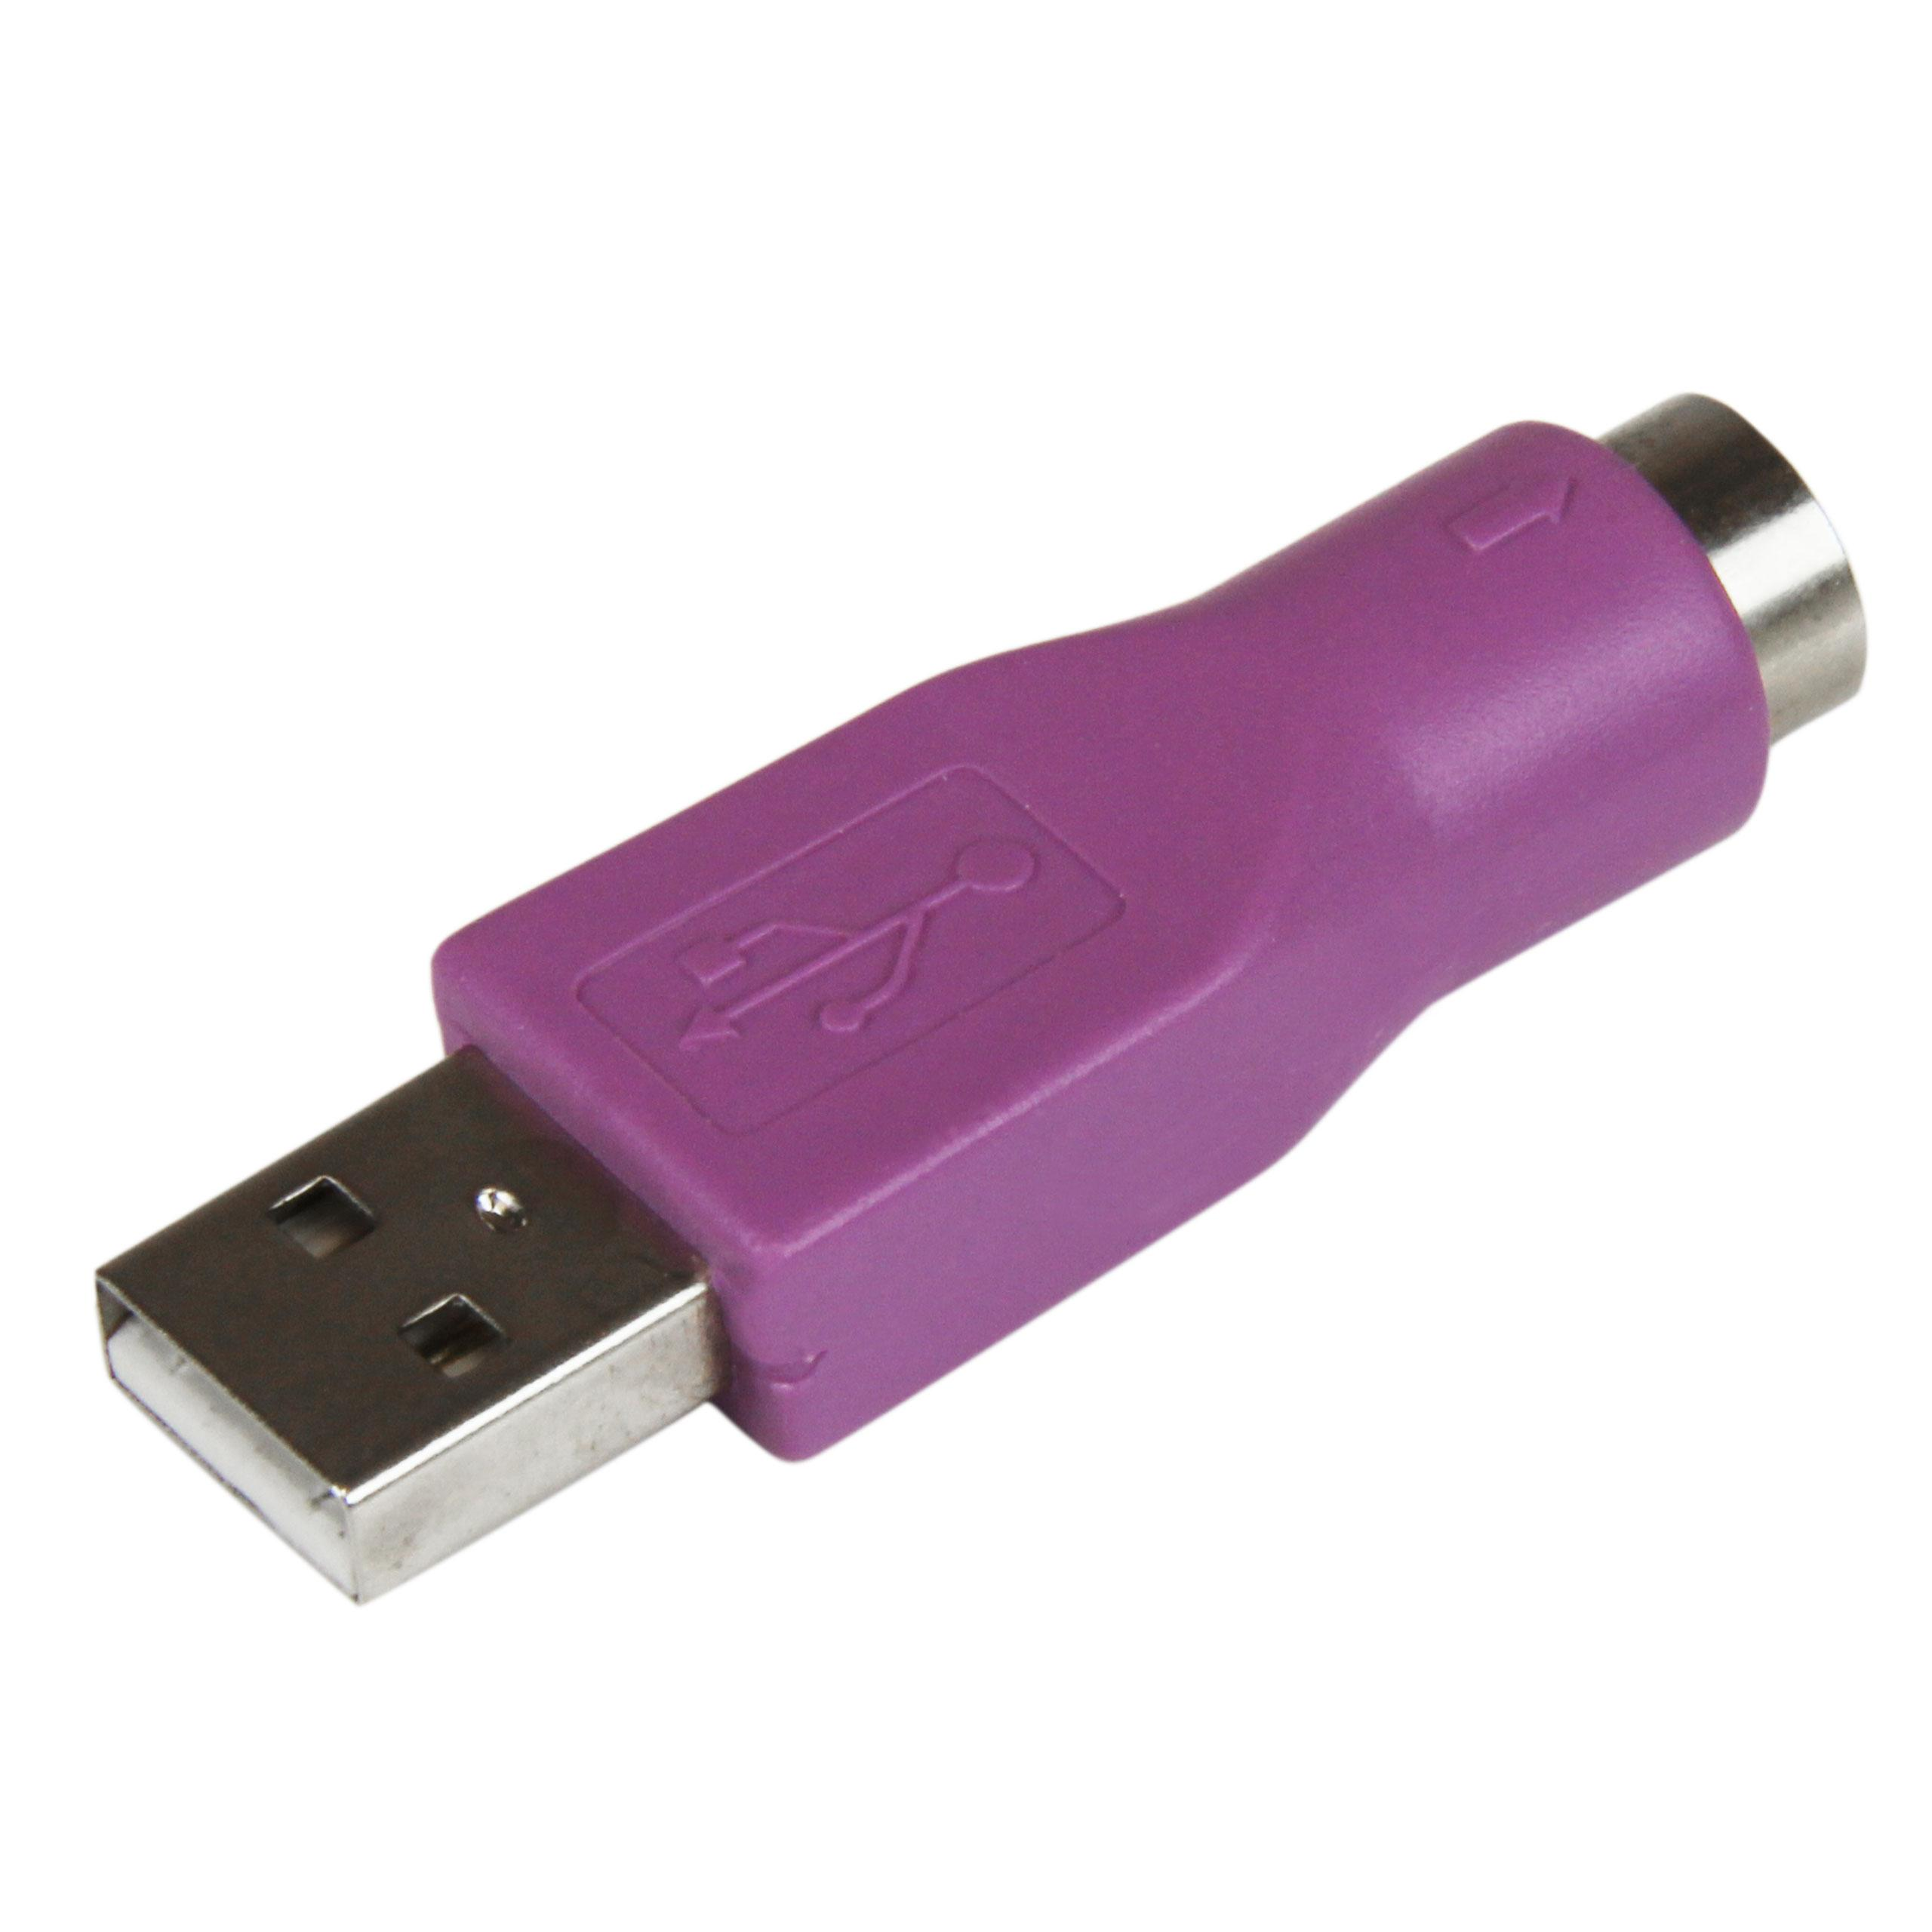
CONNECTOR TYPES & PIN DETAILS
PS/2 port - 6-pin mini DIN-Connectors.
This was introduced in 1987.
The PS/2 keyboard interface was electrically the same as for the 5-pin DIN connector on former ,AT keyboards.
USB ports -
This was created in 1995.
Type A, commonly used at computer end of cable
Micro-A (rare)
Type B, at peripheral end, rare except for printers
Micro-B, at peripheral end, for most smartphones
Type C, at either end. As of 2017, many new computers, phones and peripherals use it.

Slide 7

MOUSE

Slide 8
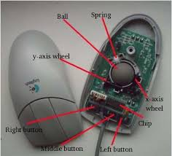
Mechanical mouse
A mechanical mouse is a computer mouse that contains a metal or rubber ball on its under side. When the ball is rolled in any direction, sensors inside the mouse detect this motion and move the on-screen mouse pointer in the same direction.

Slide 9
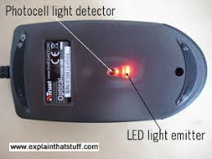
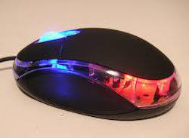
Optical Mouse
This type of mouse utilizes light-emitting diodes (LED) or laser to help track movement. These mice are identified by examining the bottom of the mouse.

Slide 10
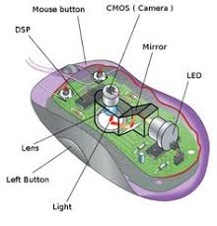
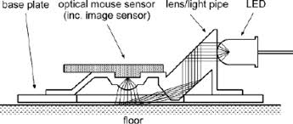

Slide 11
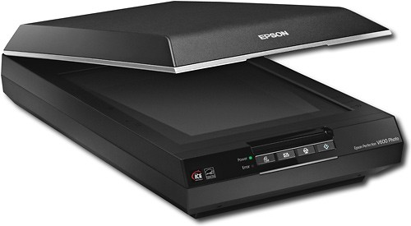
SCANNERS
A scanner is an input device that scans documents such as photographs and pages of text.
When a document is scanned, it is converted into a digital format.

Slide 12
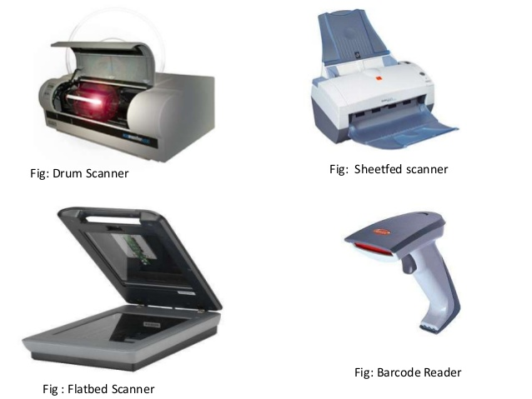
TYPES OF SCANNERS

Slide 13
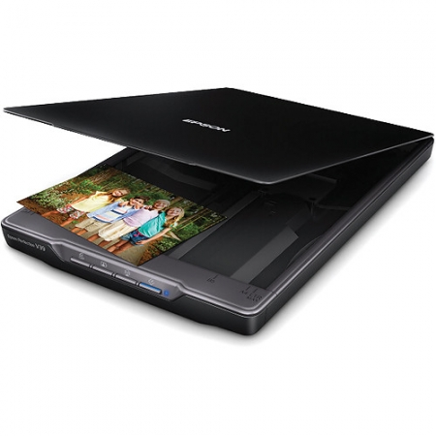
FLATBED SCANNER
Scan documents, photos, flat object from PC or laptop.
Flatbed is made up of glass pane and moving CCD array and two mirrors.

Slide 14
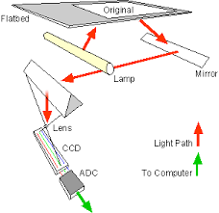
WORKING OF FLAT BED
Loading a Document
Mechanics
Optics
Sending a Document

Slide 15
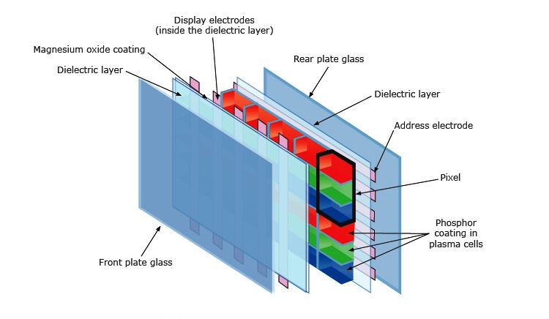
PLASMA
Plasma is referred to be the main element of a fluorescent light. It is actually a gas including ions and electrons. Under normal conditions, the gals has only uncharged particles

Slide 16
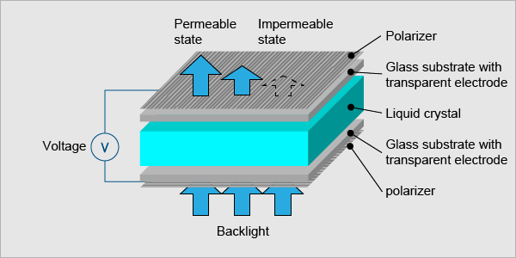
LIQUID CRYSTAL DISPLAY (LCD)

Slide 17
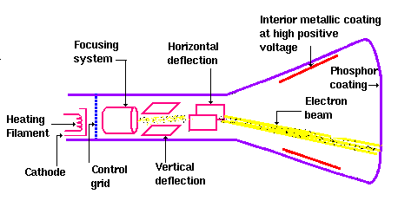
CRT monitor (Cathode Ray Tube):

Slide 18
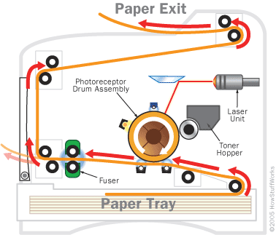
Laser printer:

Slide 19
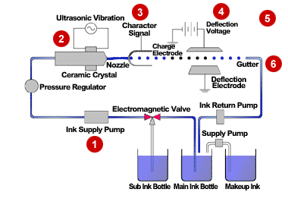
Inkjet Printer

Slide 20
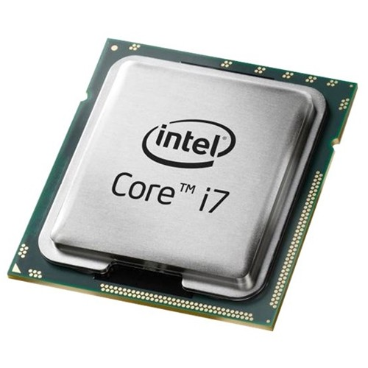
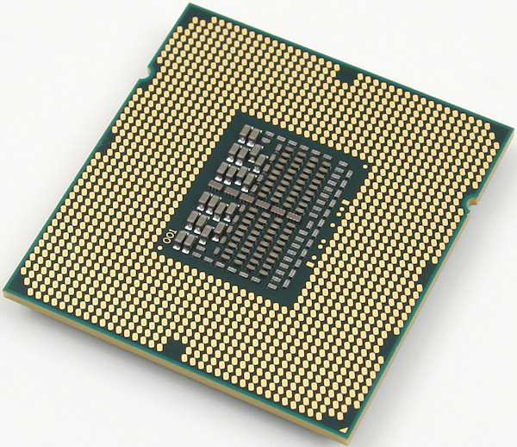
CPU
A central processing unit (CPU) is an important part of every computer.
The CPU sends signals to control the other parts of the computer, almost like how a brain controls a body.
The CPU is an electronic machine that works on a list of computer things to do, called instructions.

Slide 21
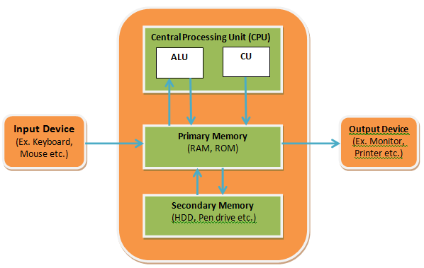
BLOCK DIAGRAM OF CPU

Slide 22
CPU BLOCKS
Clock
The clock speed typically refers to the frequency at which a chip like CPU is running and is used as an indicator of the processor's speed
Accumulator
In a computer's CPU, an accumulator is a register in which intermediate arithmetic and logic results are stored.
Program Counter
A program counter is a register in a computer processor that contains the address (location) of the instruction being executed at the current time.

Slide 23
PROCESSOR FAMILIES
The 4-bit processors
Intel 4004
The 8-bit processors
8008
8080
The 16-bit processors
8086
8088
The 32-bit processors
Pentium II
Intel Core
The 64-bit processors
Core i7

Slide 24
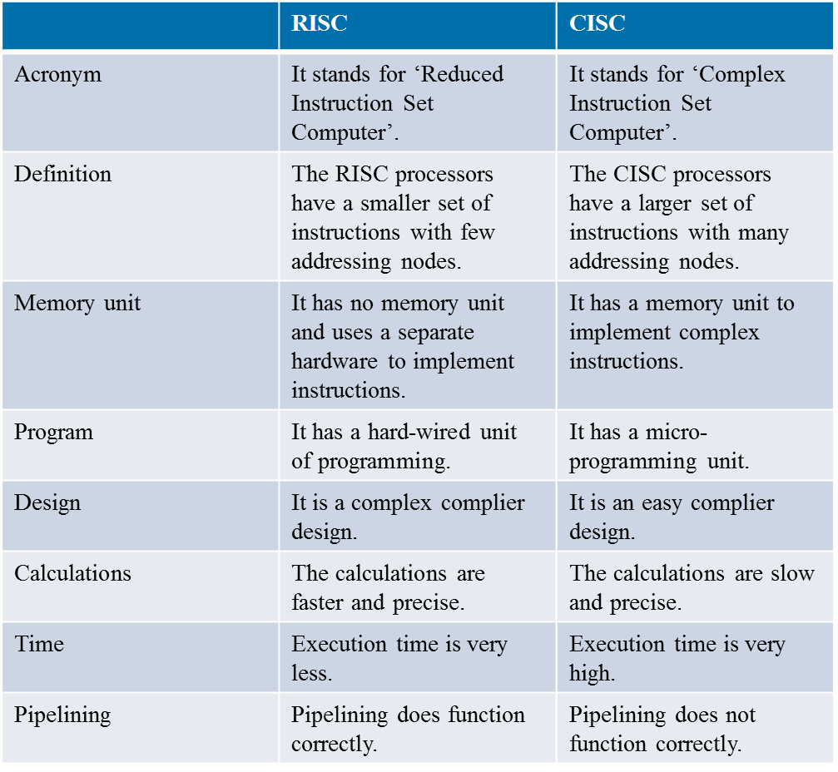
RISC AND CISC

Slide 25
OPERATION
Fetch:
In the first step, the processor fetches the instruction from the memory.
The instruction is transferred from memory to instruction register.
Decode:
In this step, the instruction is decoded by the processor.
The processor gets any operand if required by the instruction.
Execute:
In the last phase, the processor execute the instruction, it stores in register.

Slide 26
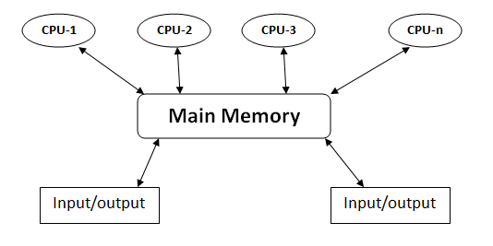
MULTIPROCESSING
Multiprocessing is the use of two or more central processing units (CPUs) within a single computer system.
Ability of a system to support more than one processor or the ability to allocate tasks between them.

Slide 27
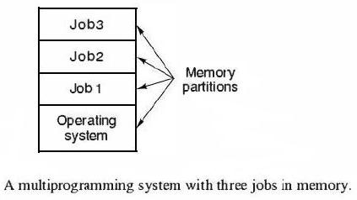
MULTIPROGRAMMING
Multiprogramming means parallel processing in which several programs are run at the same time on a uniprocessor.

Slide 28

MULTITASKING
Multitasking, in an operating system, is allowing a user to perform more than one computer task (such as the operation of an application program) at a time.
When you open your Web browser and then open Word at the same time, you are causing the operating system to do multitasking.

Slide 29
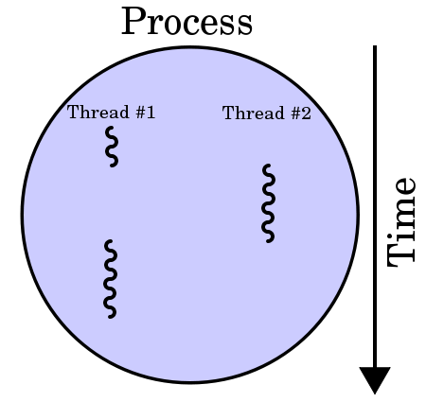
MULTITHREADING
In computer architecture, multithreading is the ability of a CPU to execute multiple processes or threads concurrently, appropriately supported by the operating system.

Slide 30
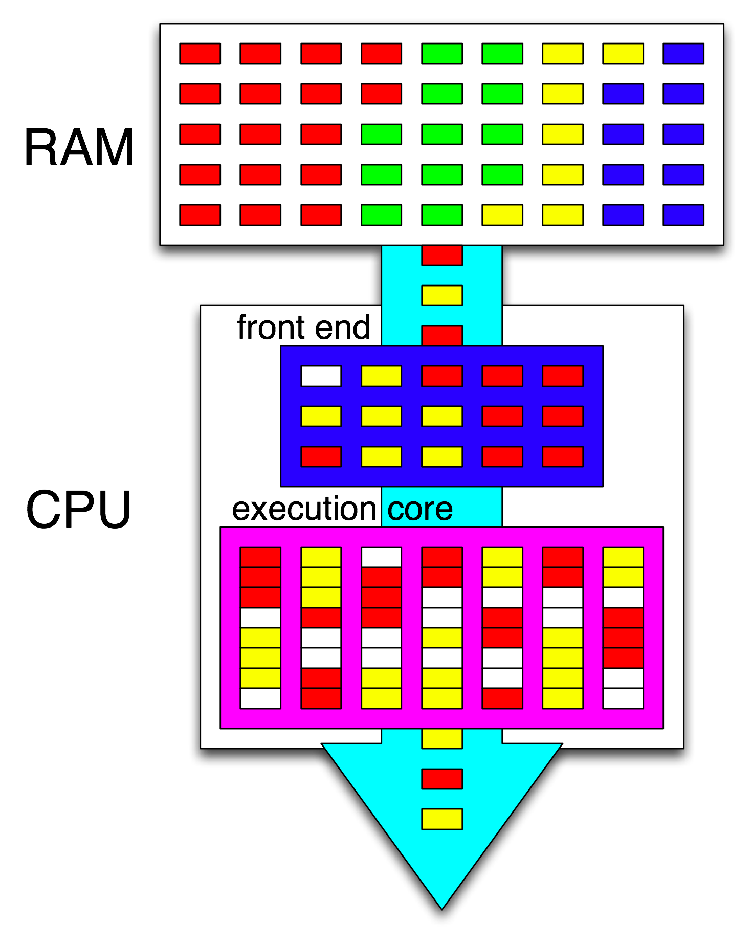
HYPER-THREADING
Hyper-Threading is a technology used by some Intel microprocessor.
It allows a single microprocessor to act like two separate processors to the operating system and the application programs that use it.

Slide 31
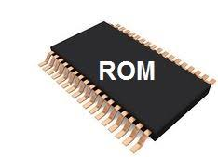
ROM (Read Only Memory)
Non volatile Memory
Memory cannot be modified easily
Helps in loading in Operating System

Slide 32
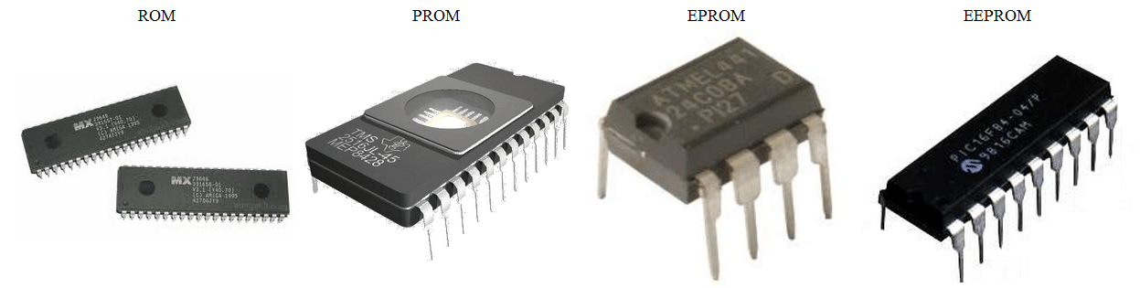
TYPES OF ROM
ROM (Read Only Memory)
PROM (Programmable Read Only Memory)
EPROM (Erasable Programmable Read Only Memory)
EEPROM (Electronically Erasable Read Only Memory)
Flash memory

Slide 33
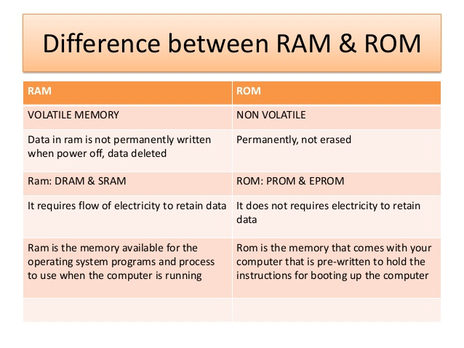

Slide 34
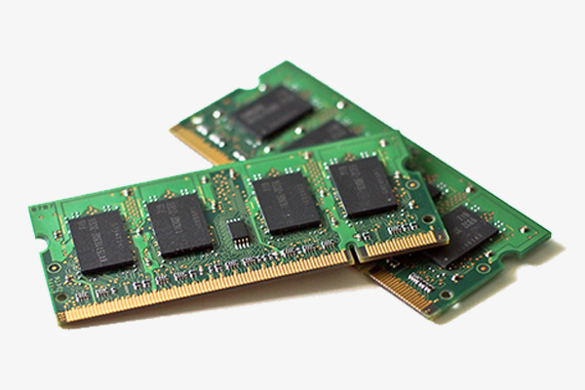
RAM (Random Access Memory)
Ram is placed in computing devices.
Operating system, Application
programs and data in current use
are stored in ram.
RAM is much faster to read from and write to than other kinds of storage in a computer

Slide 35
TYPES
RAM
SRAM
DRAM
SRAM stands for (Static Random Access Memory)
DRAM stands for (Dynamic
Random Access Memory)

Slide 36
SRAM
DRAM
Retains data bits in its memory as long as power is being supplied and uses transistor to store.
SRAM does not have to be periodically refreshed.
Static RAM provides faster access to data and is more expensive.
SRAM is used for a computer's cache memory
DRAM uses a capacitor to store each bit of data.
DRAM need to be periodically refreshed.
Dynamic Ram provides faster access to data and is less expensive.
DRAM is used for a computer’s main memory

Slide 37
TYPES OF DRAM
DRAM
DDR1
DDR2
DDR3
DDR1( Double Data Rate 1).
DDR2(Double Data Rate 2).
DDR3(Double Data Rate 3).

Slide 38
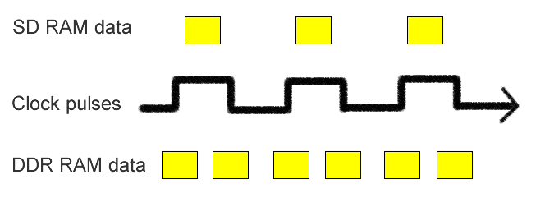
What is DDR?
"Double Data Rate" means that it can fetch data on both the up and the down cycles of the clock, unlike the previous versions of RAM which only fetched on one clock edge.

Slide 39
Comparison between DDR1,DDR2 & DDR3
DRAM | Internal Rate (MHz) | Bus clock (MHz) | Prefetch | Data Rate (MT/s) | Transfer Rate (GB/s) | Voltage (V)
DDR1 | 133-200 | 133-200 | 2n | 266-400 | 2.1-3.2 | 2.5
DDR2 | 133-200 | 266-400 | 4n | 533-800 | 4.2-6.4 | 1.8
DDR3 | 133-200 | 533-800 | 8n | 1066-1600 | 8.5-14.9 | 1.35

Slide 40
Cache Memory
Cache memory is a very high speed memory that is placed between the CPU and main memory, to operate at the speed of the CPU.
It is used to reduce the average time to access data from the main memory.
There are different levels of cache memory as follows .
Level 1 or Register
Level 2 or Cache Memory
Level 3 or Main Memory
Level 4 or Secondary Memory

Slide 41
Levels of Cache Memory
Level 1 or Register: It is a type of memory in which data is stored and accepted that are immediately stored in CPU. Most commonly used register is accumulator, Program counter, address register etc.
Level 2 or Cache Memory: It is the fastest memory which has faster access time where data is temporarily stored for faster access.

Slide 42
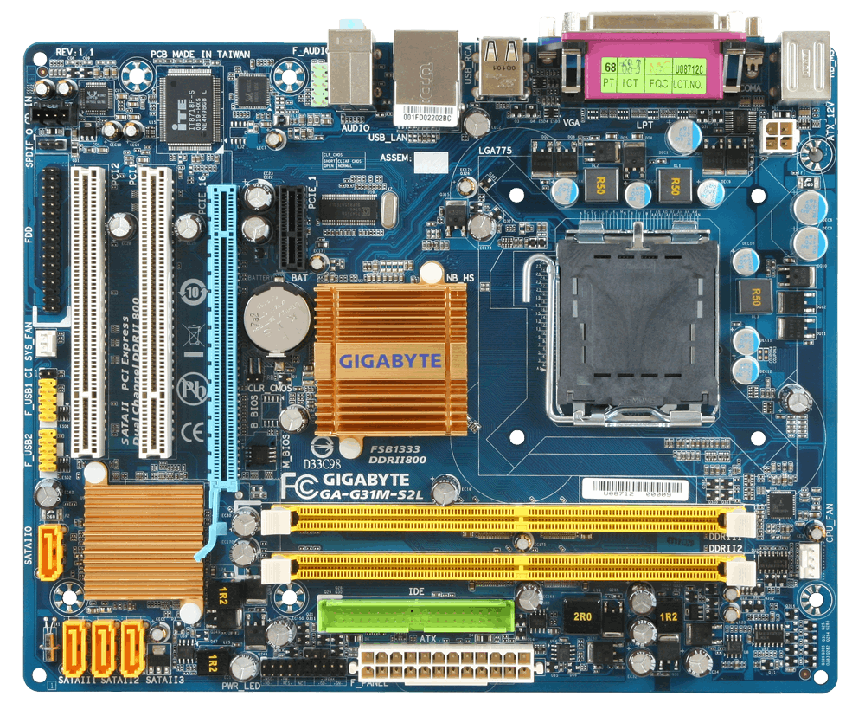
MOTHERBOARD
Motherboard is a main (PCB) printed circuit board where are all the components and devices are connected directly and indirectly.

Slide 43
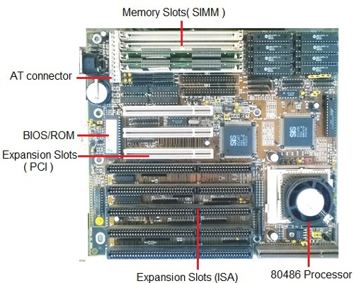
Types Of Motherboard
1. AT(Advanced technology) Motherboard:

Slide 44
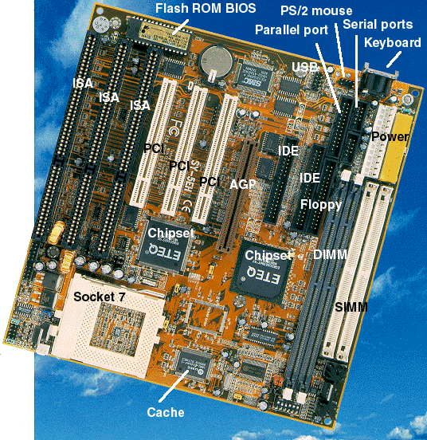
Types Of Motherboard
2. Baby AT:

Slide 45
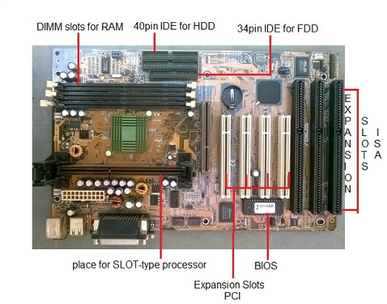
Types Of Motherboard
3 . ATX Motherboard:

Slide 46
Motherboard Components
7. Connectors
SATA Connector
IDE Connector
CPU
RAM
BIOS
CMOS Battery
Expansion Slot
ISA
PCI
AGP
6.Chipsets
North Bridge
South Bridge

Slide 47
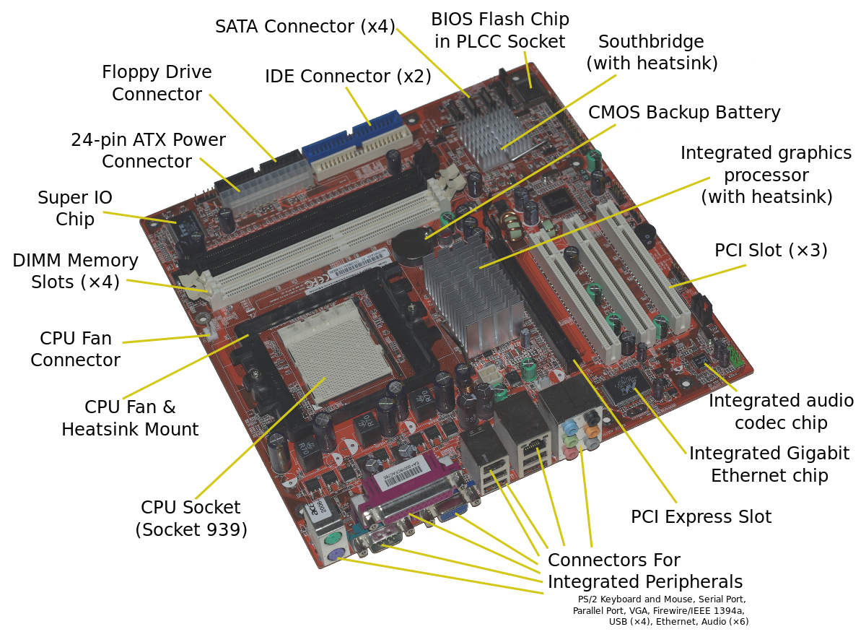

Slide 48
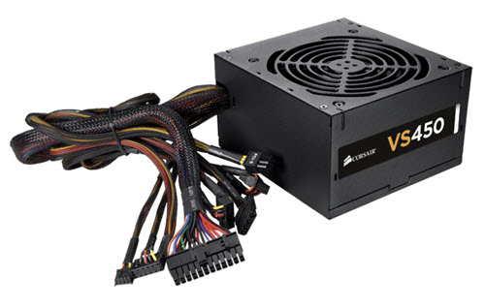
SMPS(Switching-mode power supply)
It is a device which provides power to any electrical load and involves some kind of switching action

Slide 49
Basic blocks of an SMPS
There are basically five blocks in an SMPS:
Input rectifier and filter
Chopper
Transformer
Output rectifier and filter
Feedback circuit

Slide 50
Working of SMPS
SMPS works on high frequencies.
We need to increase the frequency of 50Hz input.
So, convert the ac input to dc first and then chop it at high frequency
to get the pulsating dc output which is then applied to rectifiers and
filters.
Feedback helps to maintain the level of output signal.

Slide 51
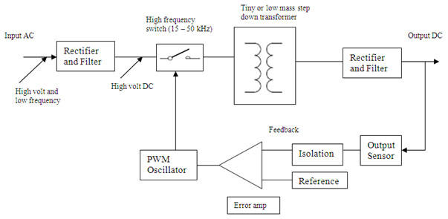
Block diagram of SMPS

Slide 52
Storage

Slide 53
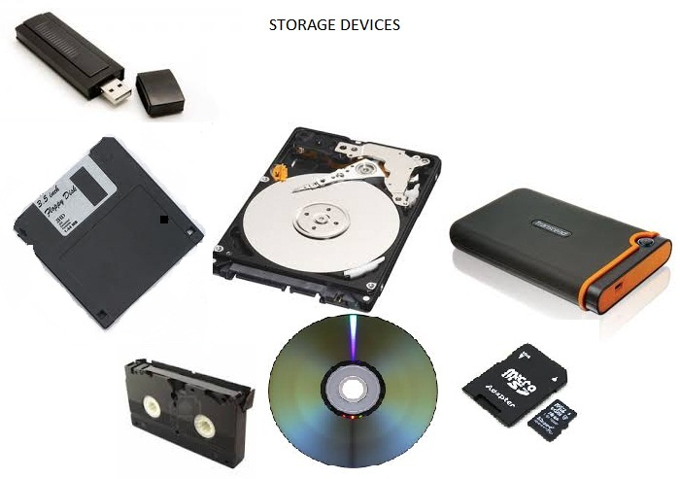
STORAGE:
A storage device is any computing hardware that is used for storing, and extracting data files and objects.

Slide 54
TYPES OF STORAGE:
There are two types of storage devices used with computers:
Primary storage device, such as RAM.
Secondary storage device, like a hard drive.
Secondary storage can be removable, internal, or external storage.

Slide 55
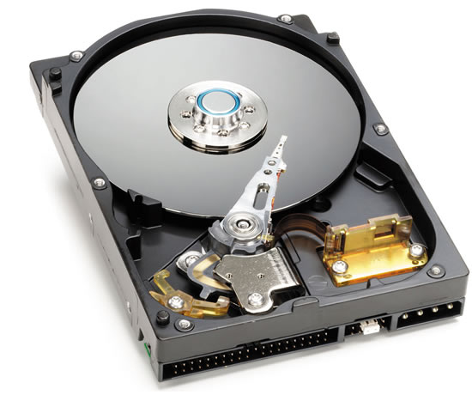
HARD DISK DRIVE
A hard disk drive (HDD), hard disk, hard drive or fixed disk is a data storage device that uses magnetic storage to store and retrieve digital information using one or more rigid rapidly rotating disks (platters) coated with magnetic material.

Slide 56
COMPONENTS:
The hard drive, which typically provides storage for data and applications within a computer, has four key components inside its casing:
The platter (for storing data).
The spindle (for spinning the platters).
The read/write arm (for reading and writing data) and
The actuator (for controlling the actions of the read/write arm).

Slide 57
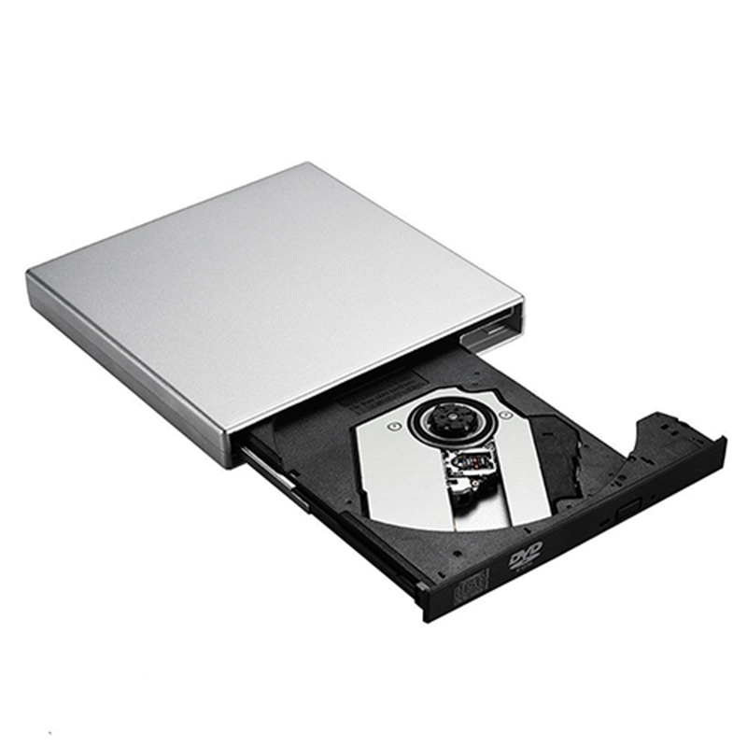
CD-ROM
CD-ROM Short for Compact Disc-Read Only Memory.
A CD-ROM is an optical disc which contains audio or software data whose memory is read only.

Slide 58
COMPONENTS:
A drive motor spins the disc. This drive motor is precisely controlled to rotate between 200 and 500 rpm depending on which track is being read.
A laser and a lens system focus in on and read the bumps.
A tracking mechanism moves the laser assembly so that the laser's beam can follow the spiral track.

Slide 59
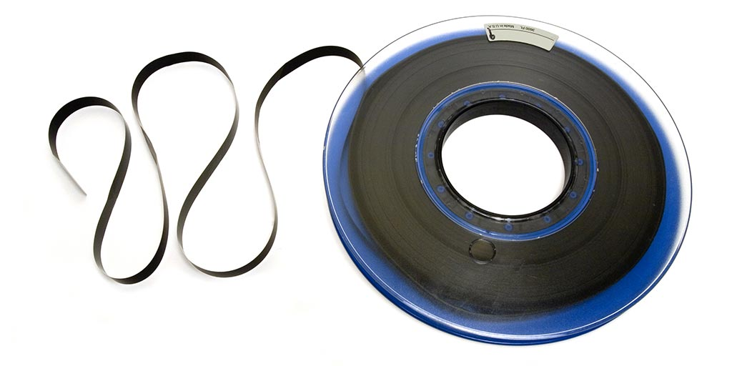
MAGNETIC TAPES
Magnetic tape is a medium for magnetic recording, made of a thin, magnetizable coating on a long, narrow strip of plastic film.

Slide 60

USB
USB released in 1996, the USB standard is currently maintained by the USB Implementers Forum (USB IF).
USB, short for Universal Serial Bus, is an
industry standard that was developed to define
cables, connectors for connection, communication,
and power supply between personal computers
and their peripheral devices.

Slide 61
USB FLASH DRIVE TO STORE DATA:
A USB flash drive, also variously known as a thumb drive, pen drive, jump drive, disk key, disk on key, flash-drive memory stick or USB memory is a data storage device that includes flash memory with an integrated USB interface.
It is typically removable, rewritable and much smaller than an optical disc.

